Slide 1
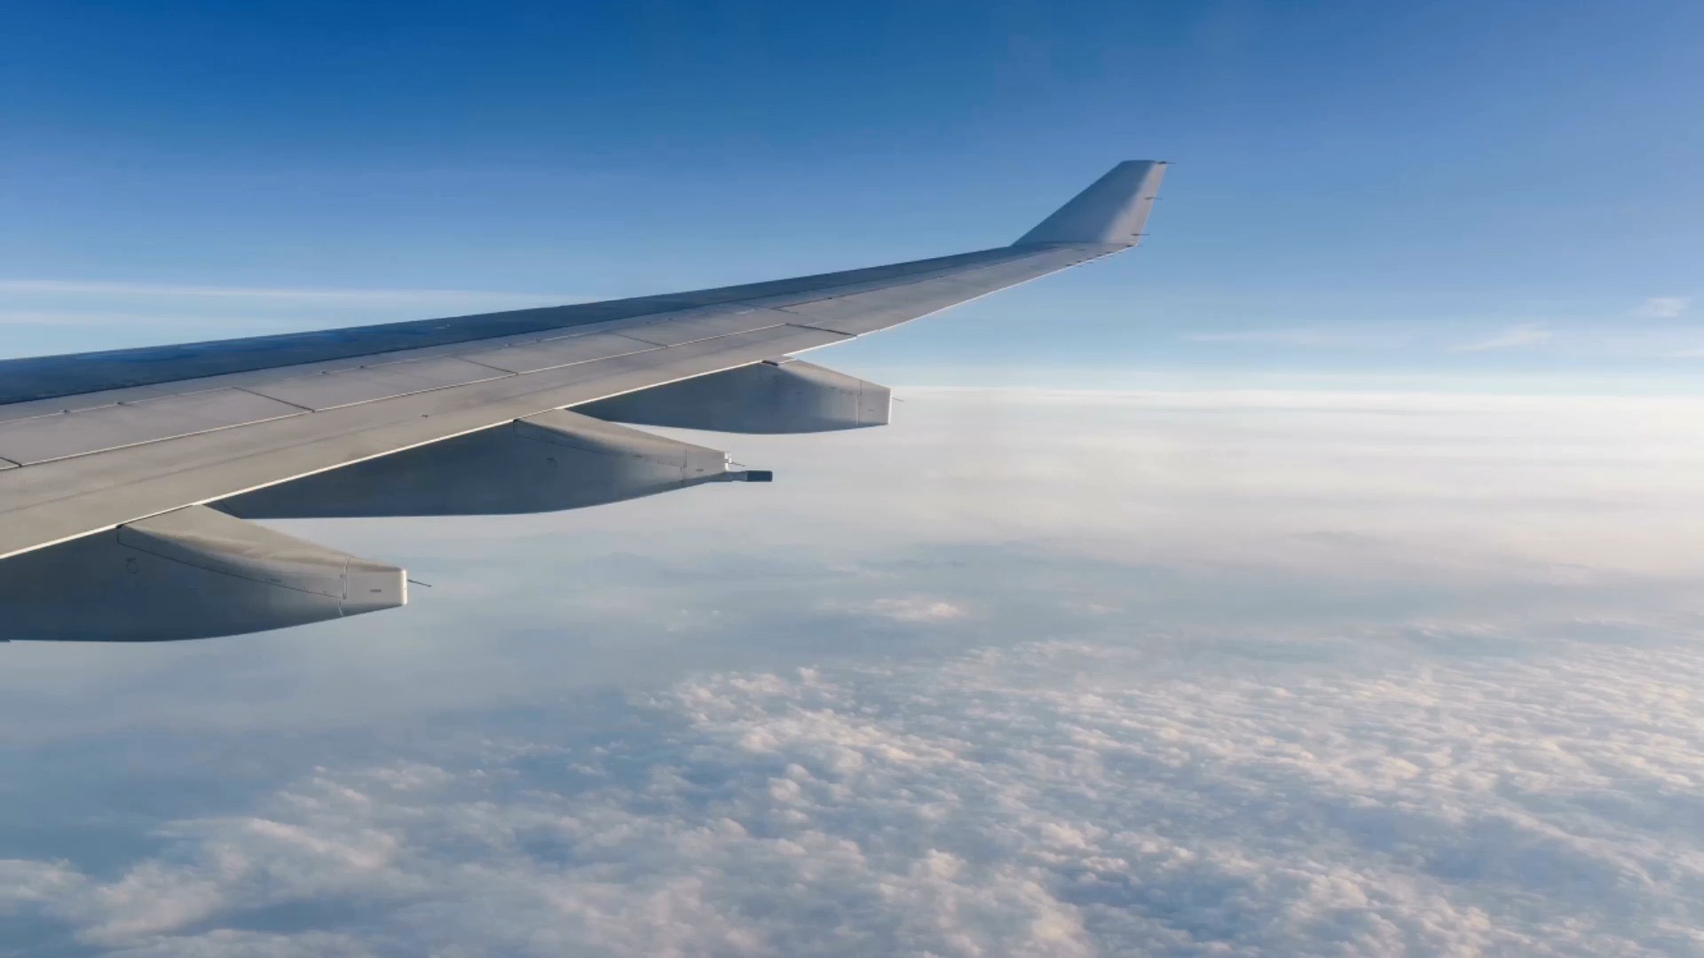
Flight Fare Prediction Analysis
By Pradeep Anipindi
Registration Number – 12300303
Lovely Professional University

Slide 2
OUTLINE
Executicve Summary
Introduction
Methodology
Results(Visulization - Charts)
Discussion
Conclusion
Appendix

Slide 3

Summary
This Project Aims to develop a predictive analysis for flight fares
The Primary Objective is to accurately forecast flight ticket prices based on various factors such as Airlines, flight duration,source_city,Stops,Destination_city and historical pricing data.

Slide 4
Introduction
About:
Analysing the prediction of flight fares
Objective:
Understanding the flight price according to various aspects and how they are varying
Identifying in which aspects the the flight prices are differniating

Slide 5
Methodology
Data Collection
Data Exploration
Data Cleaning
Data Visualization
Story telling
Presetation

Slide 6
Results
Airlines Wise Data Analysis
Source city Wise Data Analysis
Destination_city Wise Analysis
Stops Wise Data Analysis
Class Wise Data Analysis
Departure time Wise Data Analysis
Days_left Wise Data Analysis

Slide 7
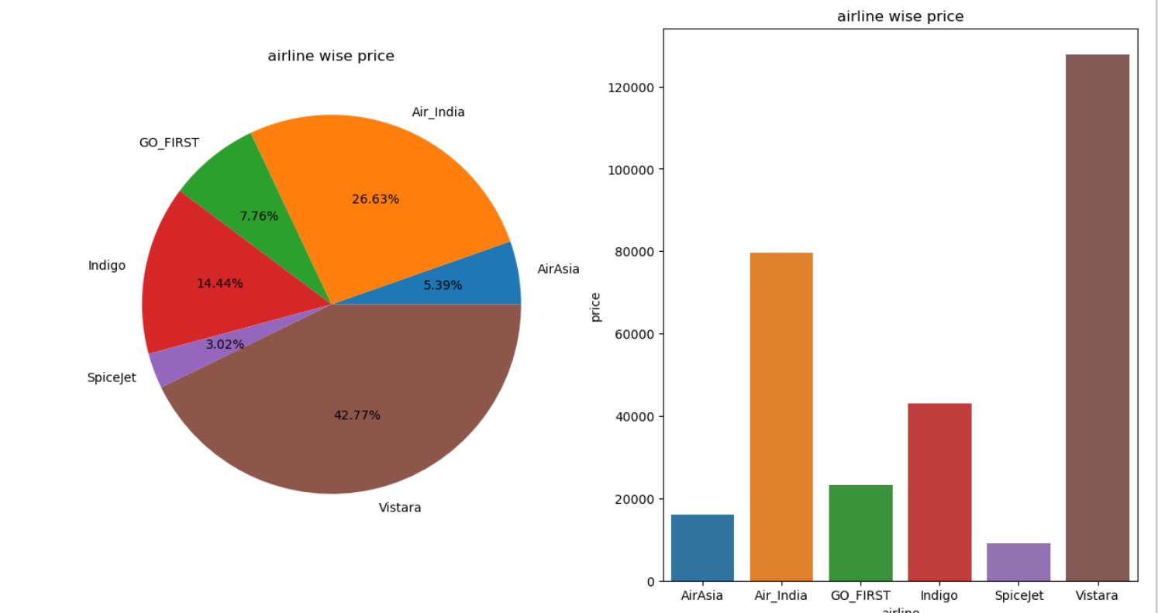
Airlines Wise Data Analysis

Slide 8
Findings
From the above data analysis we can find out that airlines Vistara has more fare value

Slide 9
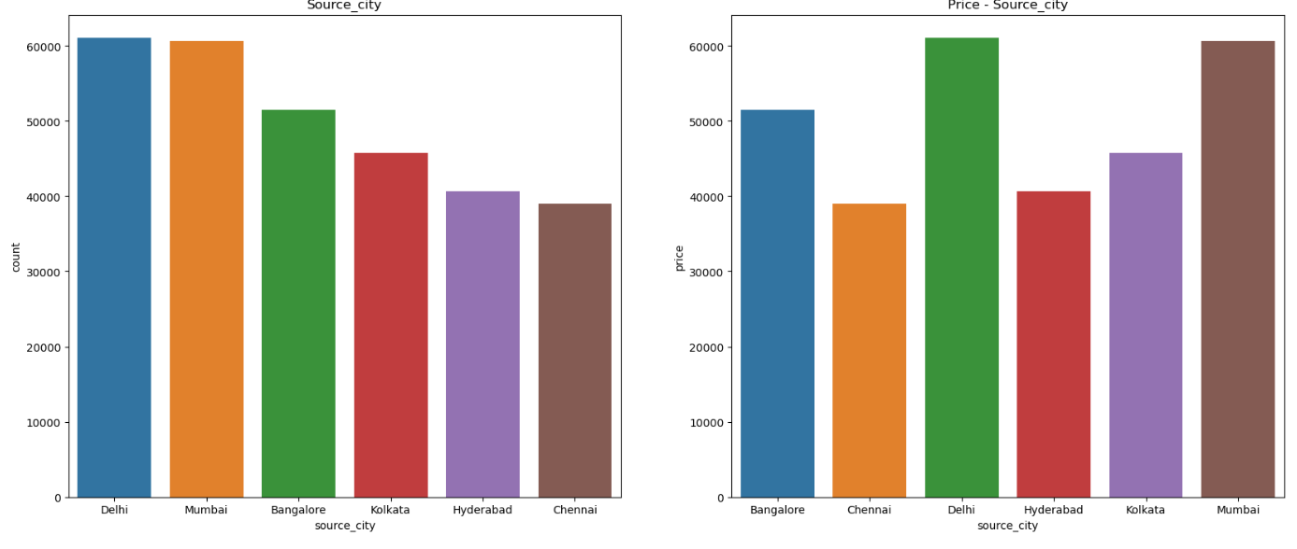
Source_city Wise Data Analysis

Slide 10
Findings
From Above chart we can observe that fights that are departing from delhi has highest fares.

Slide 11
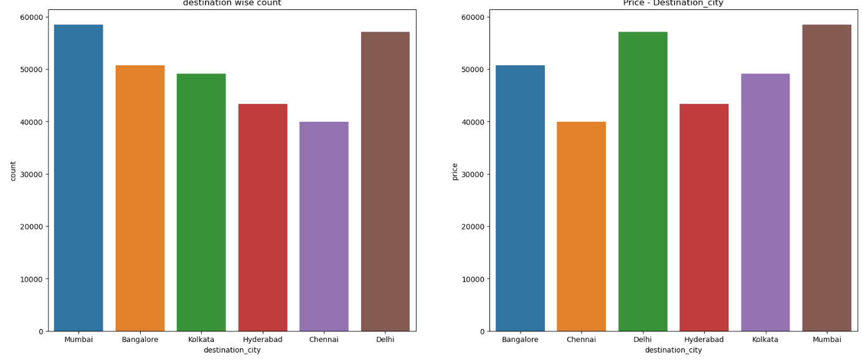
Destination_city Data Analysis

Slide 12

Findings
Flights which are landing in Mumbai destination has the more fares compare to the other cities.

Slide 13
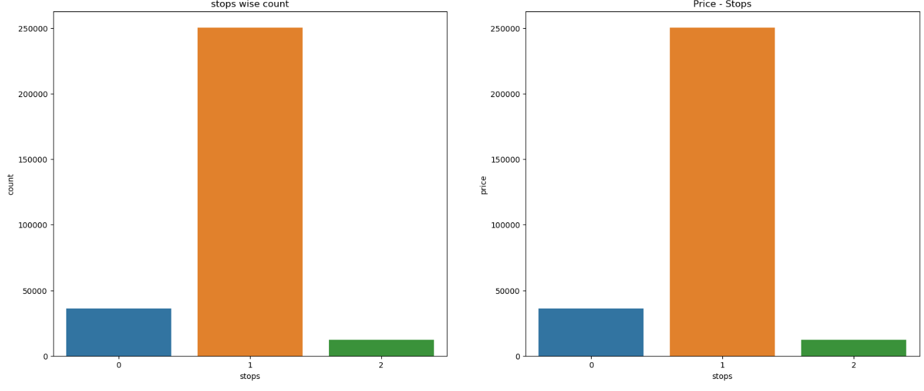
Stop Wise Data Analysis

Slide 14
Findings
From this analysis we can conclude that airlines which has only single stops(1 stop) has more fare compared to others

Slide 15
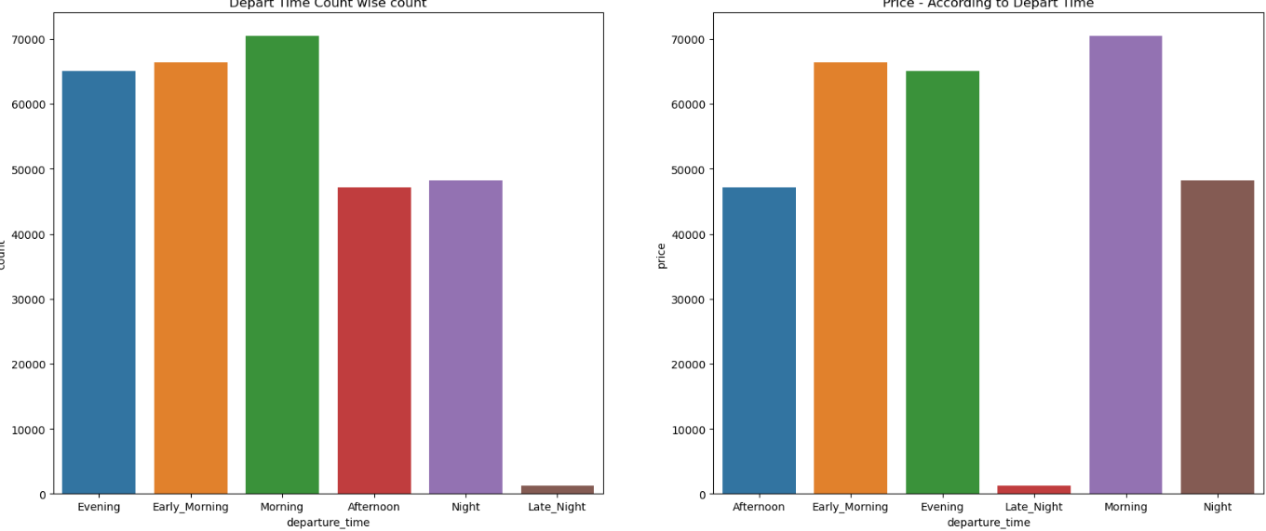
Departure_Time Wise Analysis

Slide 16
Findings
Airlines which are departing from the airport in the morning has the more fares compared to the airlines that are starting other time zones.

Slide 17
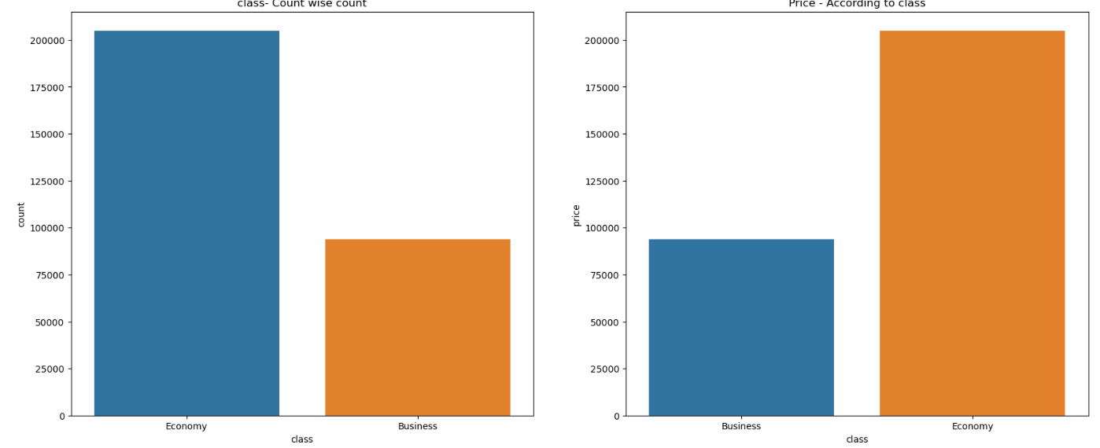
Class Wise Data Anlysis

Slide 18
Findings
Airlines of Economy class has more fares compare to business class category

Slide 19
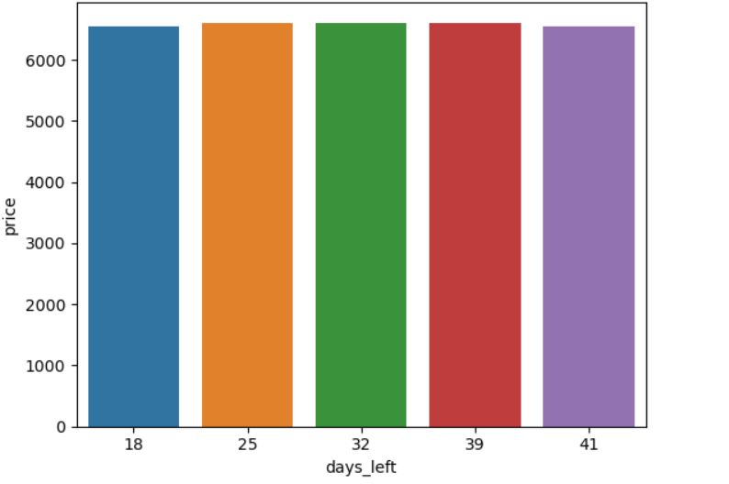
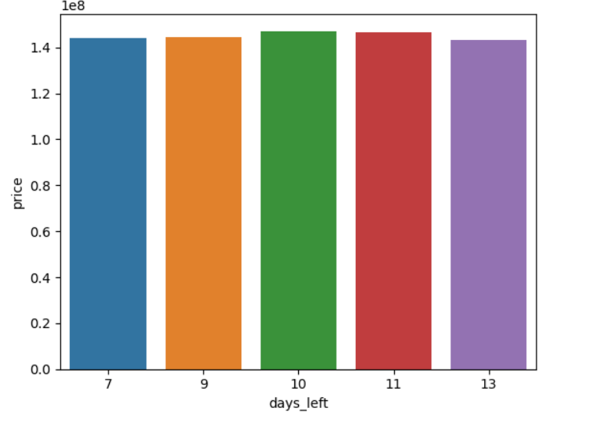
Days_left wise Analysis

Slide 20
Findings
By above chart we say that people who are booking the airlines before 10 days of their journey must pay more amount that other days

Slide 21
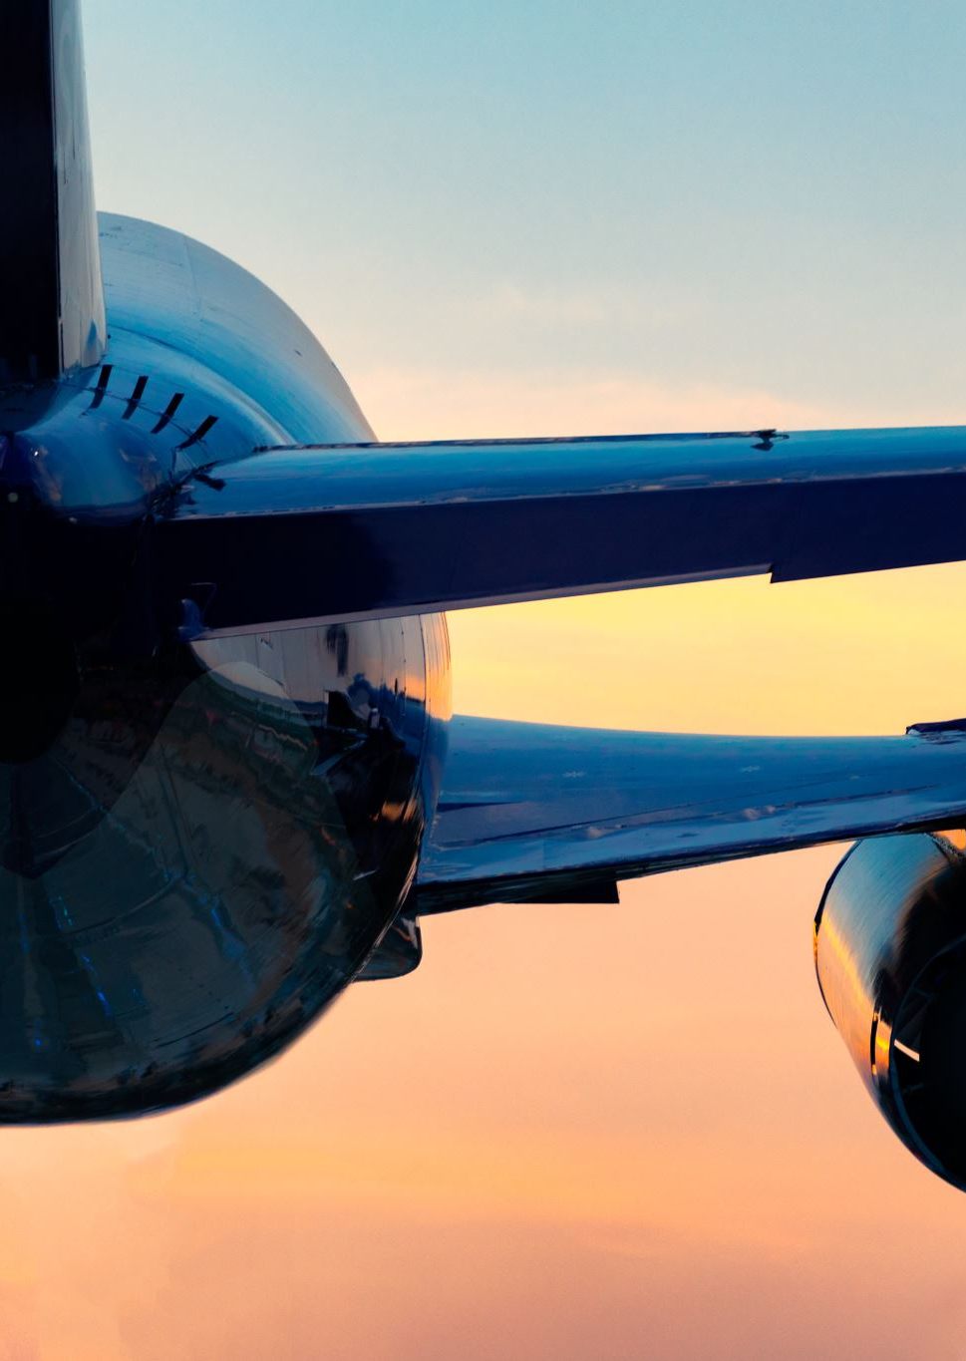
Conclusion
In overall conclusion we can say that Airlines From Vistara from Delhi to Mumbai which has only 1 stop in Between which depart from tge terminal at morning of Economy class and you book the tickets 10 days before your journey has highest fares.

